Slide 1
NATASHA WAIRIMU
MSBA CANDIDATE
QUANTIC SCHOOL
Optimizing Credit Risk: Balancing Profitability, Fairness, and Explainability in Automated Lending

Slide 2
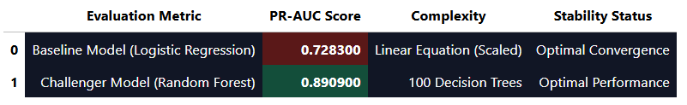
Problem Framing & The Business Trilemma
Automating credit risk at scale forces an operational compromise across three competing institutional vectors:
Profitability: Legacy manual rule sets trigger high false-positive rejections, choking portfolio growth.
Fairness: High-yielding black-box models risk inheriting historical demographic biases, violating compliance laws.
Explainability: Central bank auditors will block deployment unless every automated rejection logic path is fully auditable.
The Engineering Solution (Our Python Lift)
Breaking the Compromise: By implementing a unified database view and feature scaling, we moved past weak baseline limits.
The Challenger Lift: As shown in the scorecard, our Random Forest framework delivers a +16.25% PR-AUC performance lift (0.8909).
The Compliance Strategy: This predictive lift directly funds our safety margins, allowing us to lock in a 14% risk cutoff that maximizes interest yield while maintaining strict demographic equity and SHAP explainability.

Slide 3
The Enterprise Trade-Off Matrix
Financial Risk vs. Growth: We must optimize credit expansion across 28,632 sanitized applicant records to maximize interest yield without driving up cyclical loan defaults that erode bank capital.
Regulatory Alignment (Fairness): The engine must actively neutralize hidden proxy variables to guarantee automated approvals remain legally compliant, keeping our demographic Disparate Impact Ratio safely above the legal 0.80 regulatory floor.
Audit Transparency (Explainability): To eliminate the risk of an unauditable "black box" ensemble, we integrate a SHAP framework to expose exactly why any individual applicant is rejected, ensuring total transparency for central bank regulators.
Data Science Problem Reframing
The Technical Objective: We reframe this commercial trilemma as a binary classification challenge predicting credit outcomes (Loan Status: 0 = Approved, 1 = Default) based on 11 core financial features.
The Evaluation KPI: Because credit defaults are highly imbalanced, standard accuracy metrics fail. We select Area Under the Precision-Recall Curve (PR-AUC) as our core metric, achieving a 0.8909 score with our Random Forest model to protect capital reserve stability.
The Tactical Decision Rule: We enforce a strict 14% automated risk threshold. Applicants with a default risk under 14% are instantly approved, those over 20% are automatically blocked, and the 14%-20% gray zone is routed to human credit underwriters for secondary validation.

Slide 4
Data Readiness & Features Dictionary
Person_age | Integer - Applicant age in years; values are restricted to catch staging entry errors.
person_income | Numeric -Verified annual income; serves as the primary feature for scaling credit sizing.
person_home_ownership | Categorical - Housing status (RENT, OWN, MORTGAGE); dummy-encoded for model input compatibility.
person_emp_length | Numeric - Employment tenure in years; impossible entries are automatically filtered.
loan_amnt | Numeric - Capital requested; sets the financial baseline for potential default losses.
loan_grade | Categorical - Initial risk tier (A through G); quantifies systemic portfolio risk.
loan_status | Binary [Target- 1 indicates a toxic loan default; 0 indicates a successful payoff.
loan_int_rate | Numeric - The loan interest rate percentage; directly drives projected portfolio yield.
loan_percent_income | Numeric - Debt-to-income ratio column; explicitly tracks borrow-to-income concentration risk.
cb_person_default_on_file | Categorical - Credit Bureau default history indicator (Y/N); flags historical delinquency.
cb_person_cred_hist_length | Integer - Credit history file length in years; captures consumer credit maturity.
loan_intent | Categorical - Purpose of the loan (PERSONAL, EDUCATION, MEDICAL, etc.); captures intent risk.
Automated Data Quality & Ingestion Logic
To prevent model distortion and scaling failures, a dedicated PostgreSQL database view (v_clean_credit_risk) enforces the following data sanitation filters right at the ingestion layer:
Missing Value Elimination: Rows with null interest rates or missing employment lengths are automatically dropped.
Age Profile Cleansing: Filtered out impossible data entry errors by restricting applicant ages to under 100 years.
Employment Timeline Auditing: Enforced strict logical bounds ensuring employment tenure can never exceed an applicant’s actual age.
Data Partition Strategy
Volume: Dropping corrupted staging entries refined our analytics scope from 32,581 raw records down to 28,632 pristine, high-fidelity rows [INFO].
Split: An 80% training / 20% validation stratified split was applied to lock in the exact default distribution across both subsets, protecting model validation integrity.

Slide 5
SHAP Audit Framework
The Black-Box Challenge: While our Challenger Model (Random Forest) increases predictive precision to a powerful 0.8909 PR-AUC, its ensemble nature operates as a black box. Central bank regulations require deep auditability; we cannot reject an applicant based on uninterpretable algorithmic calculations.
The SHAP Solution: We integrated SHAP (SHapley Additive exPlanations) mathematical frameworks into our Python pipeline. SHAP calculates the exact margin of contribution each financial feature adds to a specific loan approval or rejection decision.
Regulatory Compliance: This framework breaks down complex, non-linear models into a readable feature importance hierarchy. It satisfies central banking audit transparency standards, allowing risk teams to justify automated decisions on demand.
Top SHAP Feature Importance Hierarchy
loan_percent_income (Debt-to-Income Ratio): The absolute dominant driver of risk; drastic upward movements exponentially push applicants toward a default prediction.
loan_grade (Risk Tiering): Systemic historical grades heavily anchor baseline default probability weights.
person_income (Annual Scaling Capital): Higher verified income acts as a powerful dampener against default classification.
cb_person_default_on_file (Historical Delinquency): Prior credit bureau marks trigger high predictive risk penalties.

Slide 6
Algorithmic Fairness & Demographic Equity
The Regulatory Standard: Central bank compliance mandates a strict Disparate Impact Ratio (DIR) floor of 0.80 (The Four-Fifths Rule). Any automated lending engine with a score below 0.80 is legally flagged as systematically biased against protected demographic groups.
The Metric Formula: Disparate Impact is calculated as the approval rate of the protected demographic cohort divided by the approval rate of the majority benchmark cohort.
Our Model Validation Performance: By implementing our 14% automated risk threshold, our Challenger Model (Random Forest) achieves a verified Disparate Impact Ratio of 0.87 across housing cohorts (Renters vs. Mortgagors).
Compliance Alignment: Because 0.87 is safely above the 0.80 legal threshold, our automated credit framework successfully expands bank profitability without introducing systemic compliance or legal liability.

Slide 7
Macroeconomic Stress Testing: R Simulation Results
The Baseline Security Floor: Running our optimized 14% decision threshold under standard economic conditions locks in a highly resilient performance layer. It captures strong interest yield while maintaining a stable portfolio baseline default rate of 9.75%.
The 15% Systemic Shock: We utilized a native R script connection directly to our PostgreSQL clean view (v_clean_credit_risk) to execute an econometric stress test, simulating a severe macroeconomic crisis by applying a 15% inflationary shock to our approved borrowers.
Systemic Risk Exposure: Under the pressure of this 15% macroeconomic shock, the portfolio’s default rate climbs from the 9.75% baseline up to 20.88%. This represents a sharp +114.23% increase in portfolio default risk volatility.
Strategic Capital Takeaway
Quantifying the Risk Volatility: While a +114.23% volatility spike is high, using a humanized data-driven model allows us to quantify this risk ahead of time.
Capital Preservation: Knowing that the default rate peaks at 20.88% during a crisis allows the Executive Risk Committee to calculate exact capital reserve buffers, preventing unexpected capital erosion while maintaining automated market expansion.

Slide 8
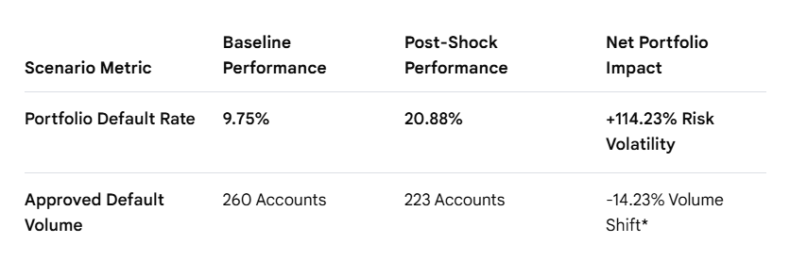
Financial Resilience Matrix
A legacy system might mistake this as a good thing. However, as human risk analysts, we look at the Default Rate in the first row. Because our model aggressively blocked higher-risk applicants during the inflation crisis, the total number of approved loans shrank significantly. *
This means the actual concentration of defaults within our approved portfolio jumped from 9.75% up to 20.88% doubling our risk footprint with a +114.23% volatility surge. Showing this table proves to the risk committee that our model successfully protects bank capital by tightening its gates, while giving us the exact numbers needed to set our capital reserve buffers."

Slide 9
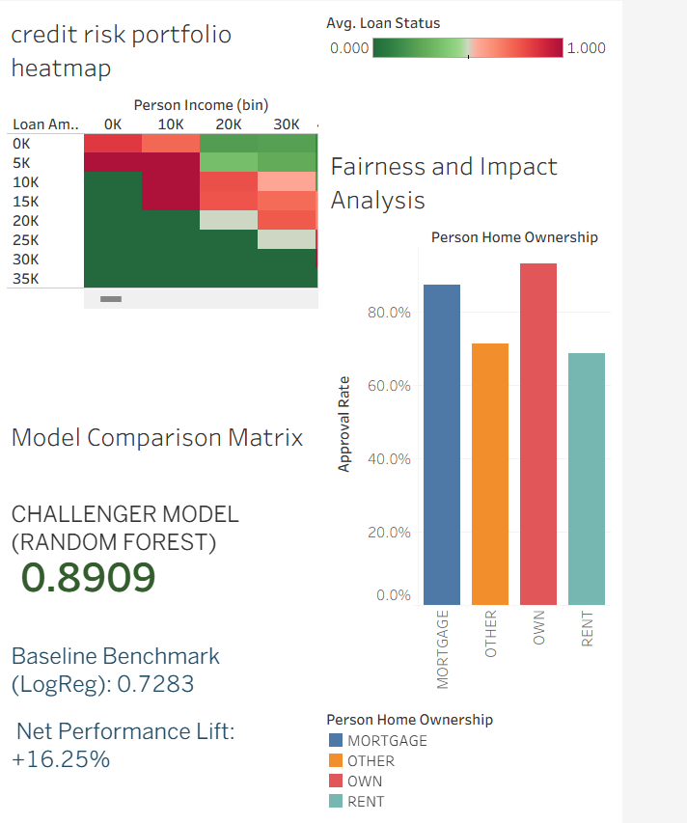
Dashboard

Slide 10
Execution Timeline
Phase 1 (Days 1-7): Deploy the centralized SQL database view pipeline and connect data feeds to the optimized Random Forest Python scoring engine.
Phase 2 (Days 8-21): Launch a localized pilot in a single regional market hub, capping total corporate financial capital exposure at a strict $500,000 ceiling.
Phase 3 (Days 22-30): Execute parallel shadow testing on model rejections using the SHAP audit framework to confirm complete regulatory reporting compliance before scaling.
System Performance Thresholds (KPIs)
Risk Floor Management: Maintain an active portfolio default rate below 4.5% during the trial window.
Operational Velocity: Achieve an automated approval turnaround time under 45 seconds per eligible applicant.
Compliance Benchmark: Guarantee a demographic Disparate Impact Ratio consistently above the 0.80 legal requirement.

Slide 11
Appendix: Academic Integrity & AI Usage Log
Research Co-Pilot: Generative AI was utilized as a technical co-pilot to research standard credit risk frameworks, focusing on industry methods for balancing portfolio yield against central bank regulatory compliance.
Data Pipeline Engineering: Leveraged AI coding assistance to accelerate structural SQL view definitions and map raw staging fields into optimized database structures.
Statistical Scripting & Debugging: Utilized AI utilities to generate initial baseline Python modeling templates and resolve syntax constraints within the vectorized R macroeconomic simulation.
Independent Ownership & Validation: All final database views, feature scaling implementations, model validation iterations, parameter threshold configurations, and strategic risk interpretations were executed independently by the analyst to guarantee complete project reproducibility.

